Slide 1
REVIEW
1. Launching IDLE
2. Difference between script and shell
3. Calculations review
4. Print function
5. Input function
Notes:
Teacher does a few exercises using print, input and calculations for about 5-10min. The students should tell the teacher what to do.

Slide 2
Python Script
Allows all commands to run at once and only stops if there is an error
Work can be saved and edited later
Good for big projects like games, apps etc.

Slide 3
9. Working with Python Scripts
Open a New File, write your name and save it on the DESKTOP
How to we differentiate FOLDERS and FILES?
Is the Python Script a FOLDER or a FILE?
How can we tell?

Slide 4
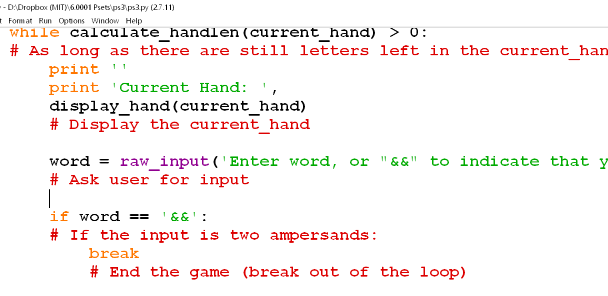
Comments
Comments are lines of code that the computer ignores that are used to explain what is happening to a person reading the code.
It is good to always write comments in your code.
Comments always start with a pound sign/hashtag symbol (#)
Notes:
Examples

Slide 5
Example 2.4: Scripts

Slide 6
Example 2.5: Taking Comments

Slide 7
Variables
What is a variable?
distance = speed * time
Notes:
Explain variables using the beginning of chapter 2 as a guideline

Slide 8
Examples
X = 2
Y = 4
myname = “Zvikomborero”

Slide 9

VARIABLES
A VARIABLE CAN TAKE ANY VALUE
Structure:
Left Right
variable_name = value
A value is any data (must have a specified data type).

Slide 10
VARIABLES
variable_name = value
You are assigning the value to the variable_name
Notes:
#Explain the principle of assignment using one equal sign. RHS is evaluated and assigned to the LHS. variable = value but value is not equal to variable

Slide 11
VARIABLES
distance = speed * time
You are assigning the speed*time to the distance. The right hand side is always calculated first and passed to the variable

Slide 12
VARIABLES
cash = float(5//3)
-cash is equal to 1.0
-1.0 is NOT equal to cash
Notes:
#Explain the principle of assignment using one equal sign. RHS is evaluated and assigned to the LHS. variable = value but value is not equal to variable

Slide 13
Defining variables in the shell
>>> x = 1
Notes:
Teacher plays with variables in the shell like in Exercise 2.1

Slide 14
Exercise: Varying Variables
s = 4
p = 3
s = p
What is p and what is s

Slide 15
VARIABLES
VARIABLE NAMING
a) small letters
b) No spaces, use underscore (__) instead
c) No using Python keywords like print
d) Name should have meaning
e) Don’t start with a number

Slide 16
Example 2.2: Easy Change

Slide 17
More variables
x = 2.3
y = 12
z = x
x = y
y = z
What is x and what is y?

Slide 18
Let’s play a game
Demonstration 2.1: Let’s be variables! (Instructor Textbook)
Notes:
Do Demonstration 2.1

Slide 19
The input(“prompt”) function
Used to get typed input from the user in the shell
Replace prompt with question

Slide 20
VARIABLES
variable_name = value (RHS evaluated first before assignment)
>>> x = input(“What is your name? “)
The computer waits for the user’s input because it is still evaluating the RHS which is calling for an input
To print what the user types in you have to type:
>>> print(x)
Notes:
#A variable used on the RHS must be defined before use. In its definition, it must contain a valid value

Slide 21
Example 2.3: Garbage in, Garbage Out

Slide 22
Python Keywords and Comments
If a word changes colour in IDLE, that means it is a keyword, do not use it as a variable name!
e.g. for, if, pass, print

Slide 23
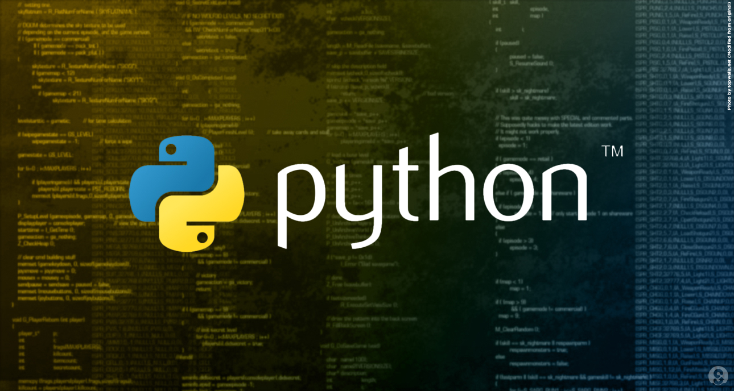
Textbook: Read Chapter 2
Questions?

